Slide 1


AI TOOLS
for different purposes
by Engr Arham Ali

Slide 2



CONTENTS
1
What is AI?
2
Flow diagram of different AI’s
3
Conversational AI tool
4
Resume score checker AI
5
Presentation Maker AI
6
Image generation AI
7
Research paper summarizer AI
8
Video Presentation maker AI

Slide 3



1
What is AI?
Artificial Intelligence (AI) refers to the simulation of human intelligence processes by machines, allowing them to perform tasks that typically require human cognitive functions.
AI systems can analyse data, learn from it, and make decisions or perform actions based on that data.

Slide 4
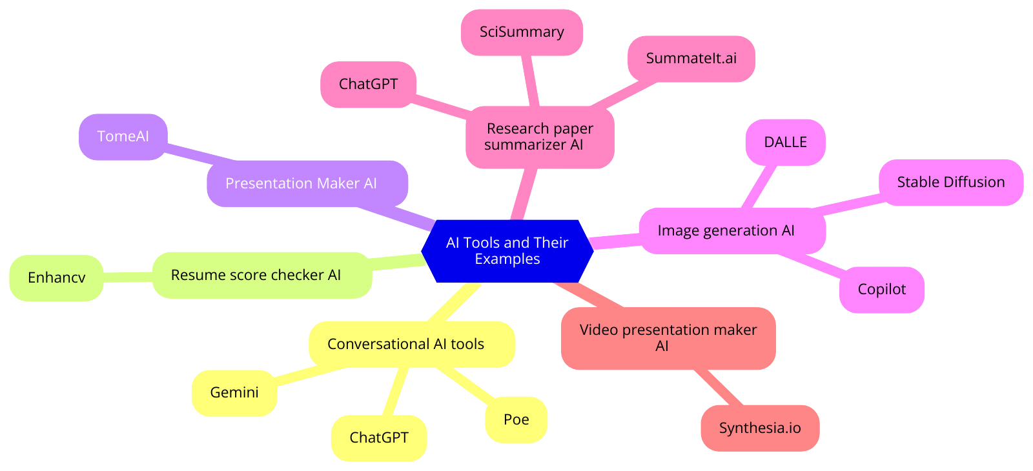
2
Flow Diagram of different ai models

Slide 5


3
Conversational ai tools
Chat gpt
gemini.ai
Useful for conversational AI like report writing script making vocabulary and grammer corrections etc
Useful when you want to search for different sources around the internet i.e research articles

Slide 6
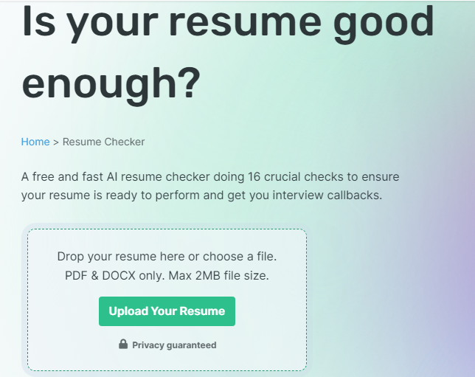
3
Resume score checker tool
enhancecv.net

Slide 7
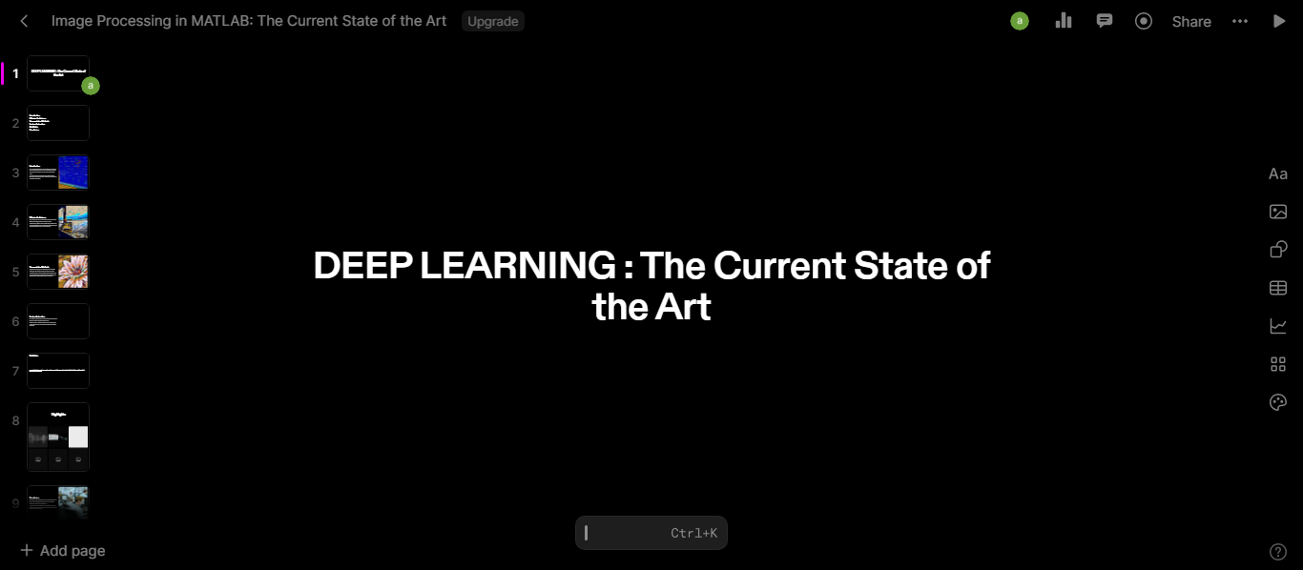
3
Presentation maker ai
tome.ai

Slide 8
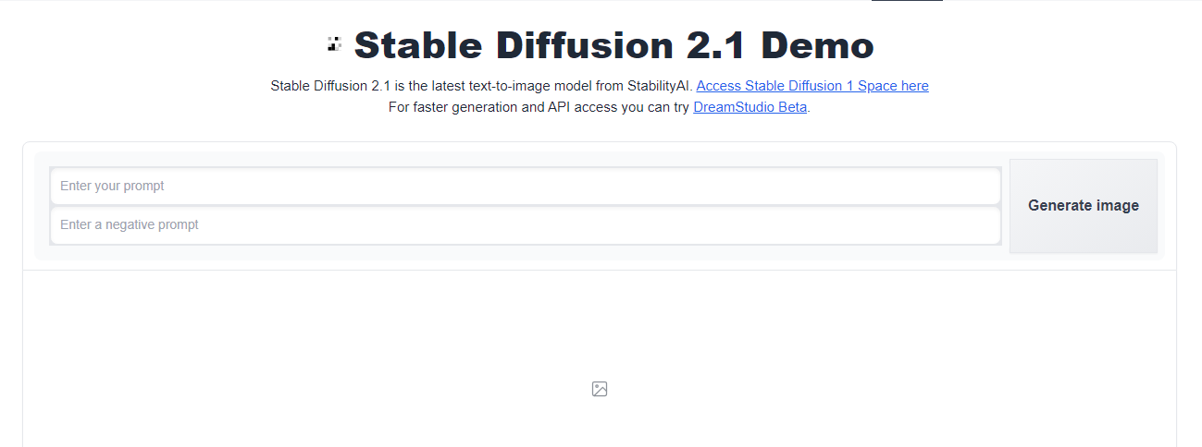
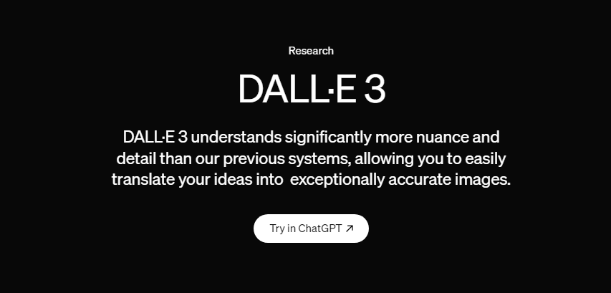
3
image generation tool
dalle & stability diffusion

Slide 9
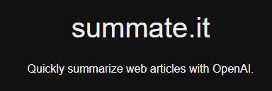
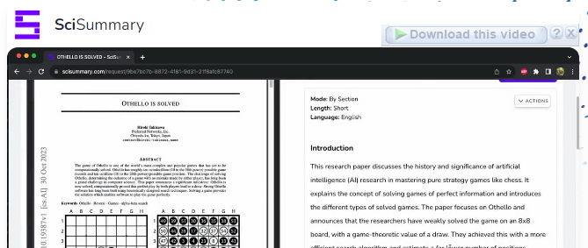
3
Research paper summary tool
Summateit and scisummary

Slide 10
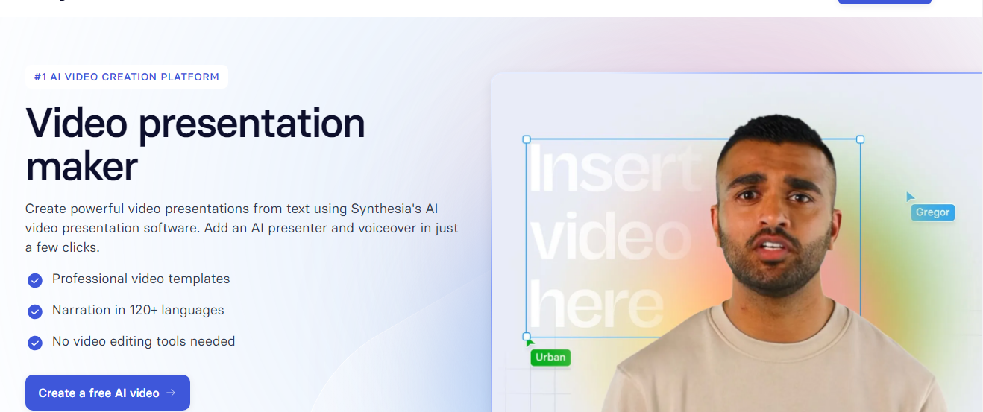
3
Video Presentation maker AI
Synthesia.io

Slide 11



Some specific
prompts?

Slide 12


PLEASE HELP ME CREATE A LINKEDIN HEADLINE COMMUNICATING MY EXPERIENCE, QUALIFICATIONS, AND UNIQUE VALUE. CONSIDER INCORPORATING KEYWORDS RELEVANT TO MY INDUSTRY AS MENTIONED IN THE RESUME BELOW AND SHOWCASING MY PASSION OR MISSION. MY HEADLINE SHOULD BE A SNAPSHOT THAT CAPTURES ATTENTION AND ENCOURAGES VISITORS TO EXPLORE MY PROFILE FURTHER." MY RESUME: [PASTE YOUR RESUME]
CRAFT A CONCISE AND COMPELLING SUMMARY FOR MY LINKEDIN PROFILE HIGHLIGHTING MY PROFESSIONAL JOURNEY, KEY SKILLS, AND WHAT MAKES ME UNIQUE. KEEP THE TONE CONVERSATIONAL AND ENSURE THE LENGTH DOES NOT EXCEED 150 WORDS. PLEASE FIND THE ATTACHED RESUME FOR REFERENCE." MY RESUME: [PASTE YOUR RESUME]
CRAFT ME IMPACTFUL AND DETAILED ENTRIES FOR MY EXPERIENCE SECTION IN LINKEDIN THAT GO BEYOND JOB DESCRIPTIONS. SHARE NOT ONLY WHAT I DID BUT HOW MY CONTRIBUTIONS MADE A DIFFERENCE. UTILIZE ACTION VERBS, QUANTIFY ACHIEVEMENTS WHERE POSSIBLE, AND PROVIDE CONTEXT TO HIGHLIGHT THE VALUE I BROUGHT TO EACH ROLE. USE MY RESUME BELOW FOR THE DETAILS" MY RESUME: [PASTE YOUR RESUME]

